Slide 1
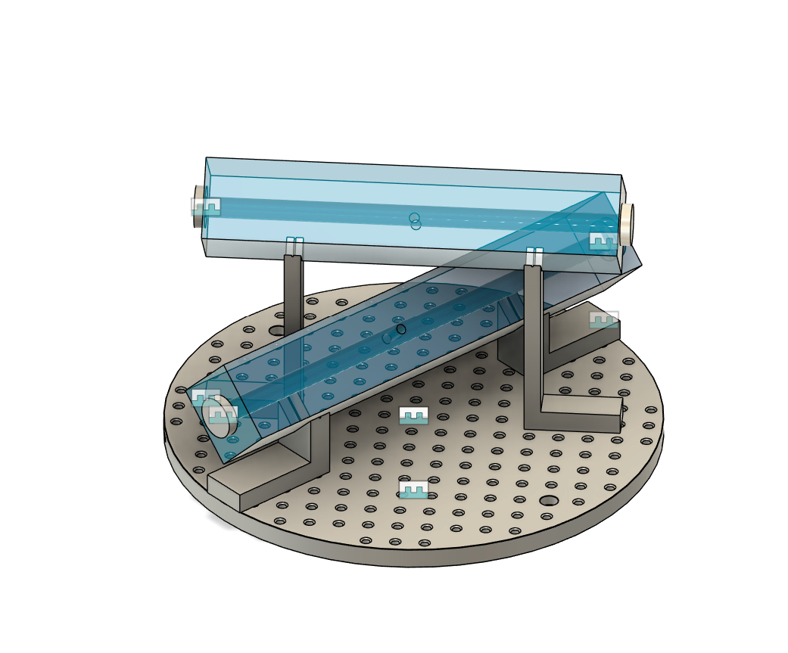
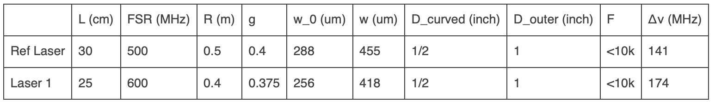
Cavities
Parallelism //<5’ guaranteed – geometrically this should be approximately equivalent to a beam shift of about 3 to 4 spot sizes
Philip is helping to design the mounts.

Slide 2
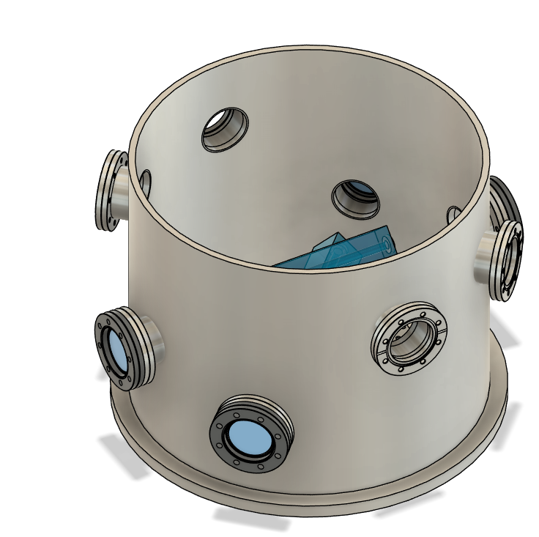
Vacuum Tank and Pumps
Pfeiffer hasn’t gotten back to me yet (with their quote)
The plan for the top plate is to have a big CF flange.
For pumps
Leybold – turbo and scroll pump together 5k (SAP shop)
Waiting for quotes for ion pumps (Gamma Vacuum and Agilent)

Slide 3
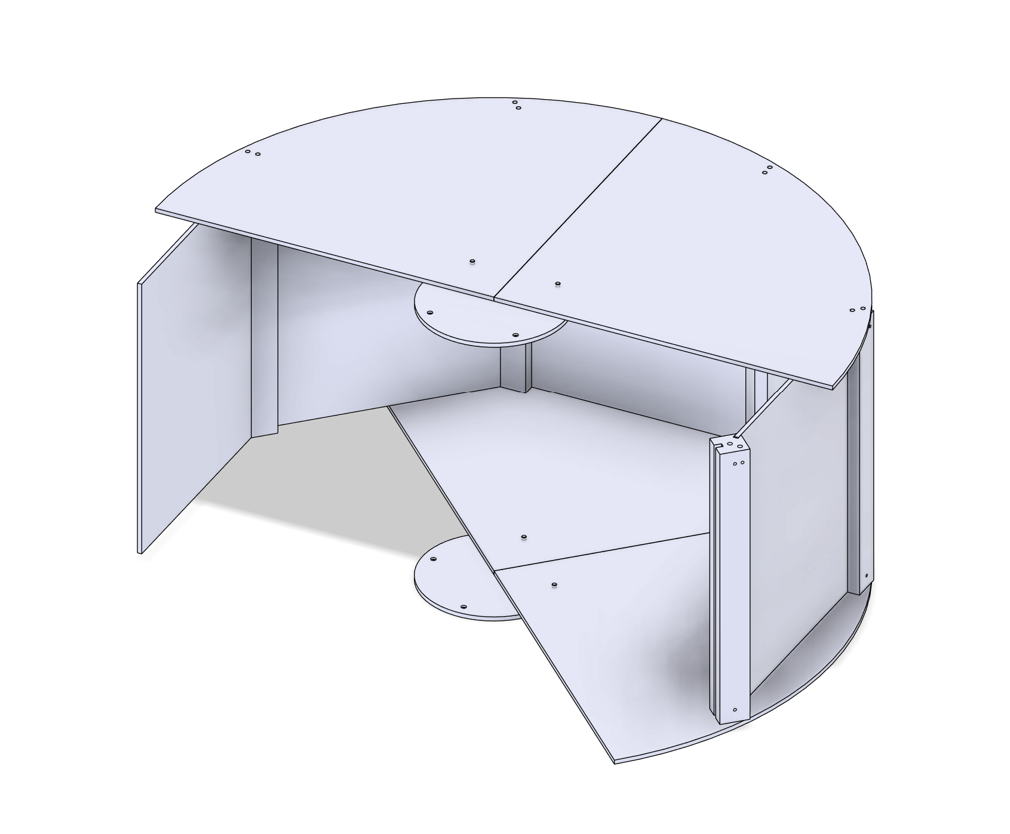
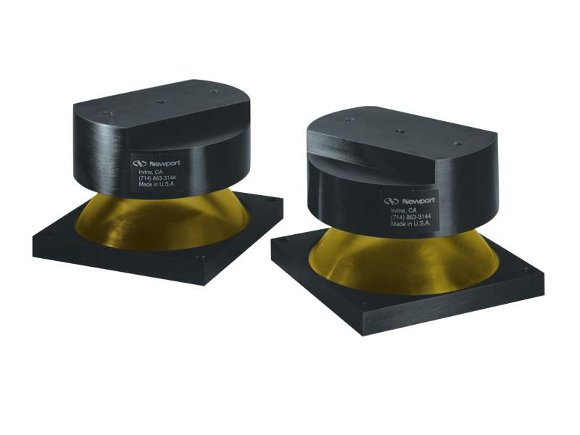
Thermal Shields
Philip designed a shield that can be assembled inside the vacuum tank.
Ceramic spheres as spacers between shields.
Possibility of adding pins for fixing them more in place.
Can be polished
Top and bottom plates can be in one piece or in four if we might need to assemble them in the tank.
The thermal shield assembly will need supports/legs
These can be bought off the shelf, but Philip is also working on something for another group.

Slide 4
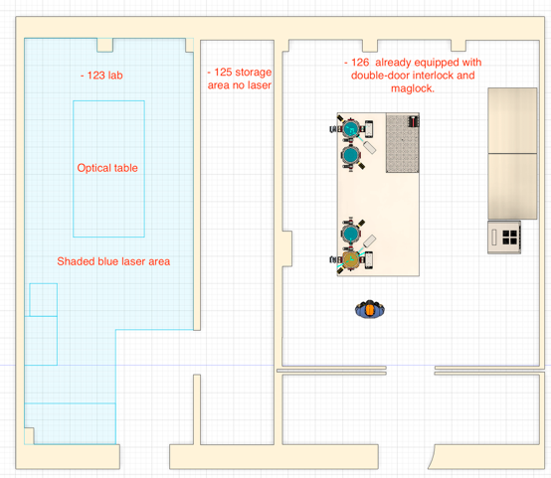
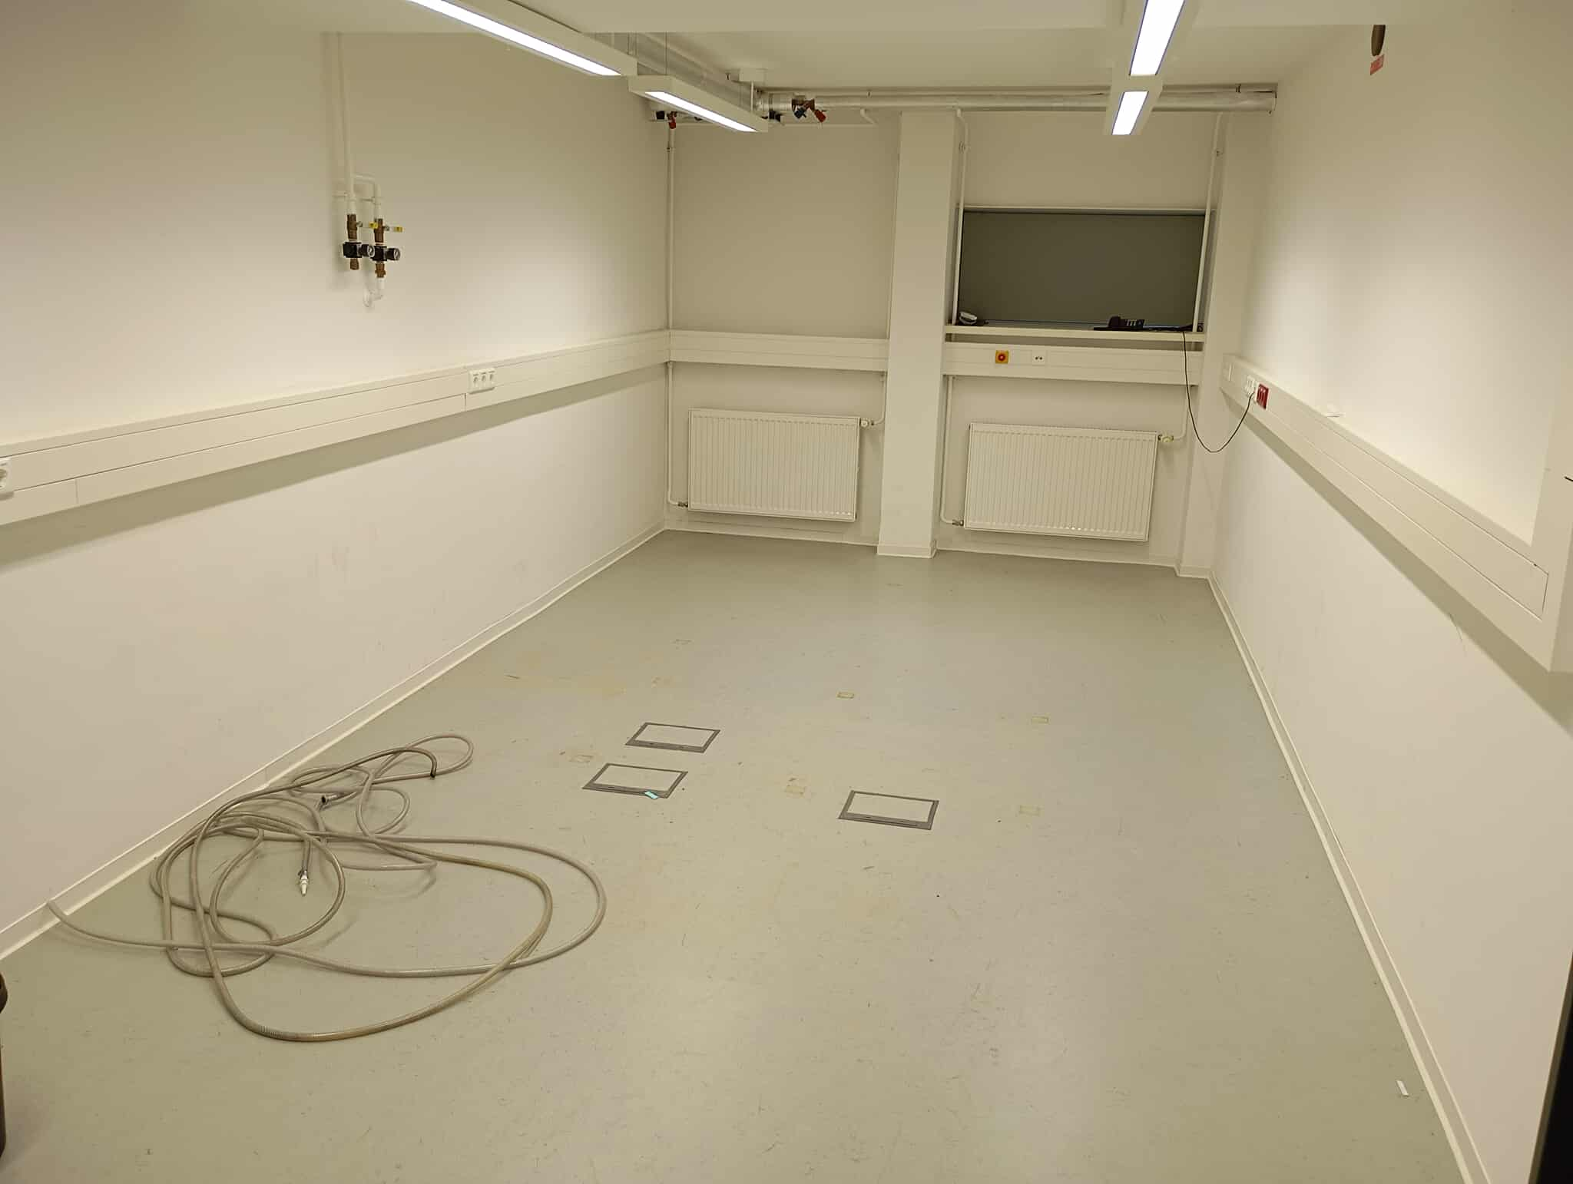
Lab room
The table will be shipped on the 24th.
Niko will take care of the interlock and laser safety wall
The room is empty.

